Slide 1



Unsupervised Learning: Clustering
29-11-2020

Slide 2





Hello!
I am Daniela Miranda
And I’m here because I’m passionate about Data Science

Slide 3


Where are we in the Bootcamp?
Linear Regression
Exploratory Data Analysis
Unsupervised Learning + Clustering
Supervised Learning (Random Forest)
Neural Networks
Convolutional Neural Networks (CNN)
Natural Language Processing
Special topic
Real-Life project

Slide 4
Agenda
What is Unsupervised Learning?
What is clustering?
Types of clustering
Proximity measures
Clustering analysis standard workflow – PART 1
EDA and data processing
Dimensionality reduction: PCA
Finding the optimal number of clusters
Clustering analysis standard workflow – PART 2
Clustering algorithms: K-means
Evaluation metrics
Common industry applications

Slide 5
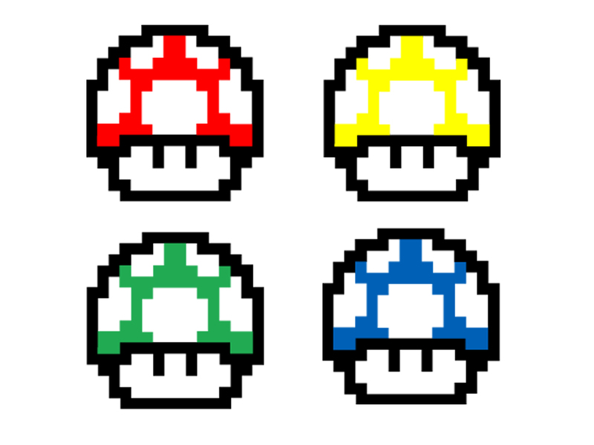

Today’s challenge
The stakeholder
The situation
The questions
What kind of mushrooms?
Which ones are better for the stakeholder?
…

Slide 6
Unsupervised Learning
A machine learning technique in which the model (algorithm) works on its own to discover patterns and information that was previously undetected. No labels are given
Common situations:
High dimensional data that needs further investigation
Pattern detection
Data exploration in an organized way

Slide 7
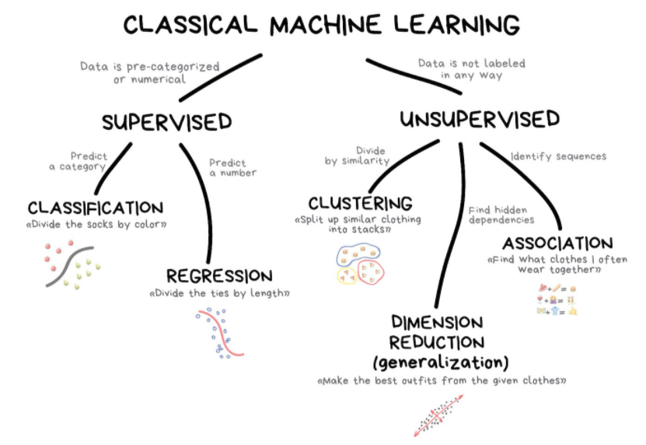
Unsupervised Learning
Source (Highly recommended): https://vas3k.com/blog/machine_learning/?fbclid=IwAR0NjjOJlZt4-KiaBGi11DskcBHAa2d6xaUchkPZdDch7pxS5sbcrZkUBJA

Slide 8
Clustering
It mainly deals with finding a structure or pattern in a collection of uncategorized data. Clustering algorithms will process your data and find natural clusters(groups) if they exist in the data. You can also modify how many clusters your algorithms should identify. It allows you to adjust the granularity of these groups.
Cluster:
A collection of objects which are “similar” between them and are “dissimilar” to the objects belonging to other clusters.
Notes:
Lloose definition: the process of organizing objects into groups whose members are similar in some way

Slide 9

Types of clustering: Exclusive
Data are grouped in such a way that one data can belong to one cluster only.
Example: K-means

Slide 10
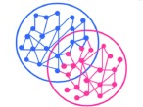
Types of clustering: Overlapping
Each point may belong to two or more clusters with separate degrees of membership.
Example: Fuzzy C-Means
C-Means clustering on Iris dataset: https://www.kaggle.com/prateekk94/fuzzy-c-means-clustering-on-iris-dataset

Slide 11
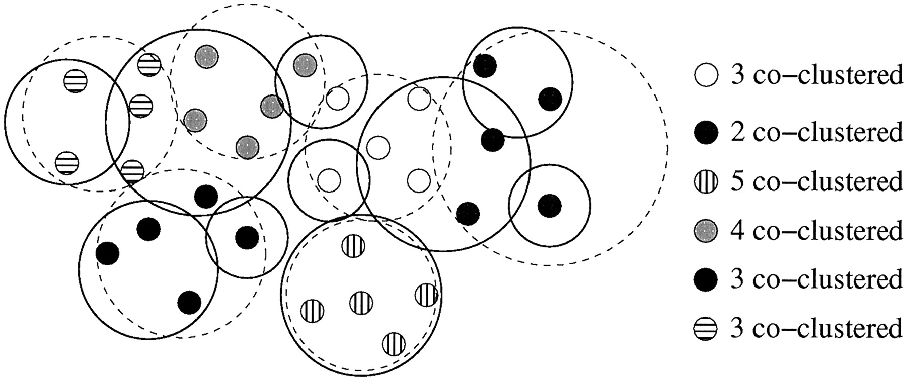
Types of clustering: Probabilistic
This technique uses probability distribution to create the clusters.
Example: Following keywords
"man's shoe.“
"women's shoe.“
"women's glove.“
"man's glove."
Can be clustered into two categories "shoe" and "glove" or "man" and "women."
Gaussian mixture models in Scikit-learn: https://scikit-learn.org/stable/modules/mixture.html

Slide 12
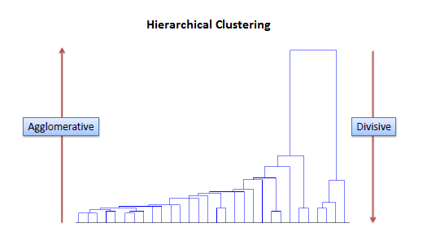
Types of clustering: Agglomerative
Agglomerative clustering implementation in Scikit-learn: https://scikit-learn.org/stable/modules/generated/sklearn.cluster.AgglomerativeClustering.html
Notes:
In this clustering technique, every data is a cluster. The iterative unions between the two nearest clusters reduce the number of clusters.

Slide 13

Proximity measures
For clustering, we need to define a proximity measure for two data points. Proximity here means how similar/dissimilar the samples are with respect to each other.
Similarity measure S(xi,xk): large if xi,xk are similar
Dissimilarity(or distance) measure D(xi,xk): small if xi,xk are similar

Slide 14
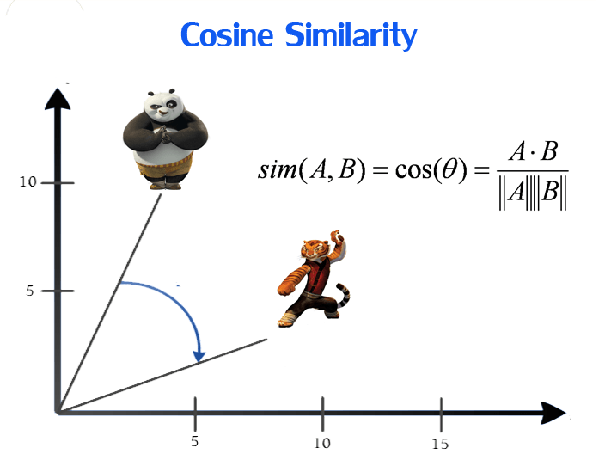
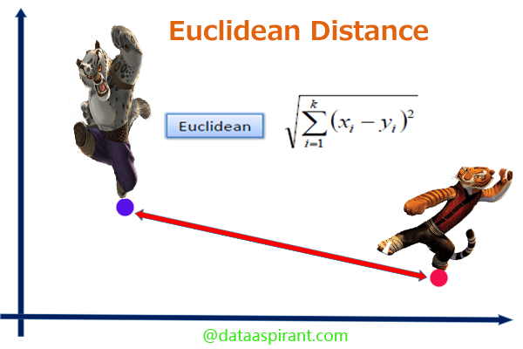
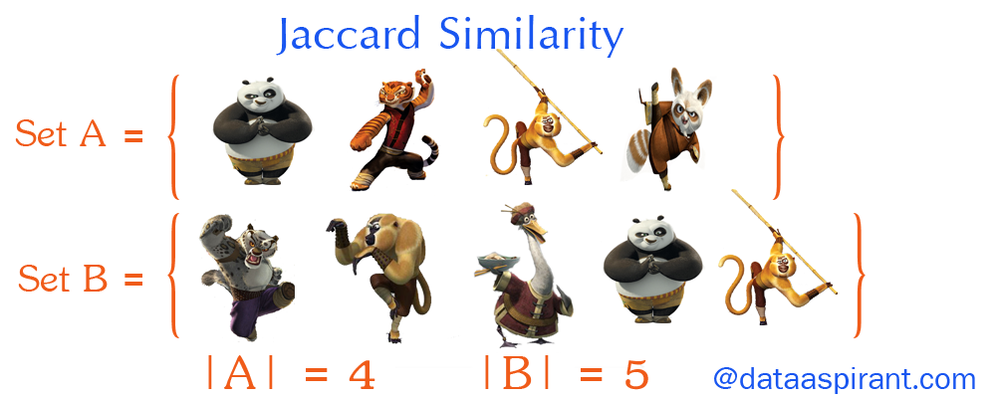
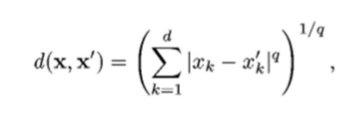
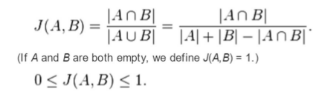

Proximity measures
Cosine distance
Euclidean distance
Jaccard distance
Notes:
Jaccard distance
Euclidean distance
q=2

Slide 15
Agenda
What is Unsupervised Learning?
What is clustering?
Types of clustering
Proximity measures
Clustering analysis standard workflow – PART 1
EDA and data processing
Dimensionality reduction: PCA
Finding the optimal number of clusters
Clustering analysis standard workflow – PART 2
Clustering algorithms: K-means
Evaluation metrics
Common industry applications

Slide 16
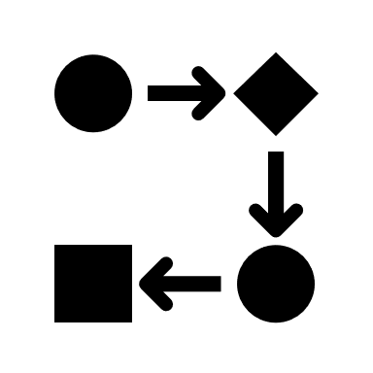
Clustering analysis standard workflow
what does a clustering project look like? (in general)

Slide 17
Data pre-processing and EDA
Dimensionality reduction
Finding the optimal number of clusters
Clustering
Evaluation

Slide 18
Data pre-processing and EDA
Remove empty values
Standardize data types
Scale

Slide 19
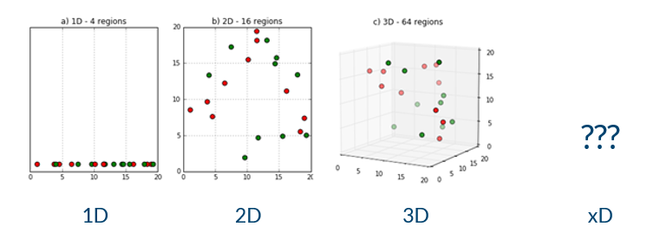
Dimensionality reduction
When data has a high dimension (many features), it is extremely complex to process. Dimensionality reduction refers to techniques that reduce the number of those dimensions, while retaining some meaningful properties of the original data.
Notes:
The Curse of Dimensionality
We care because the curse of dimensionality demands that we do. The curse of dimensionality refers to all the problems that arise when working with data in the higher dimensions, that did not exist in the lower dimensions.
As the number of features increase, the number of samples also increases proportionally. The more features we have, the more number of samples we will need to have all combinations of feature values well represented in our sample.

Slide 20
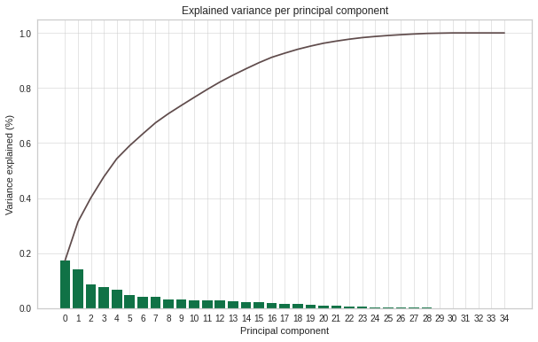
Dimensionality reduction: PCA
Principal Component Analysis (PCA) identifies variables that are responsible for most of the variance in the data. It enables to identify correlations and patterns in a dataset so it can be transformed into a dataset of significant lower dimensions and keeping the most relevant information.

Slide 21
PCA under the hood
Standardize the data
Build the covariance matrix
Calculate the Eigenvectors and Eigenvalues
Compute Principal Components
Reduce the data dimensions

Slide 22
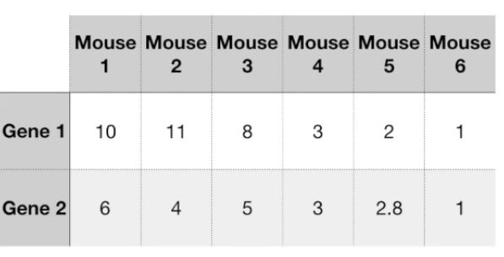
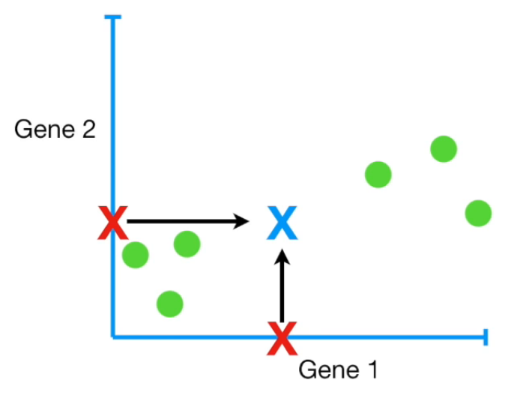
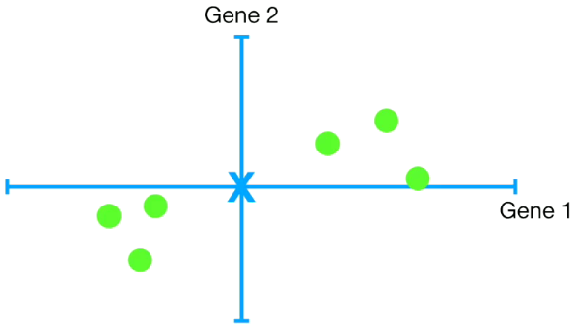
PCA under the hood
Standardize the data
Images source: StatQuest: PCA step by Step

Slide 23
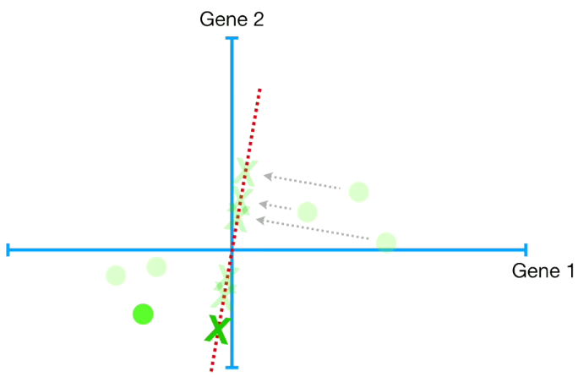
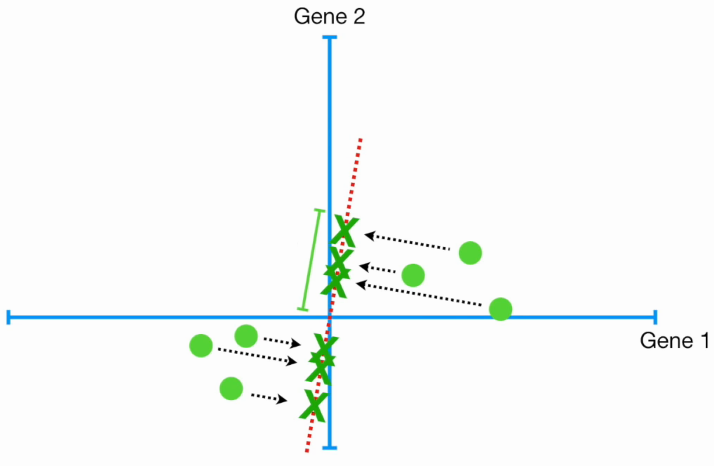
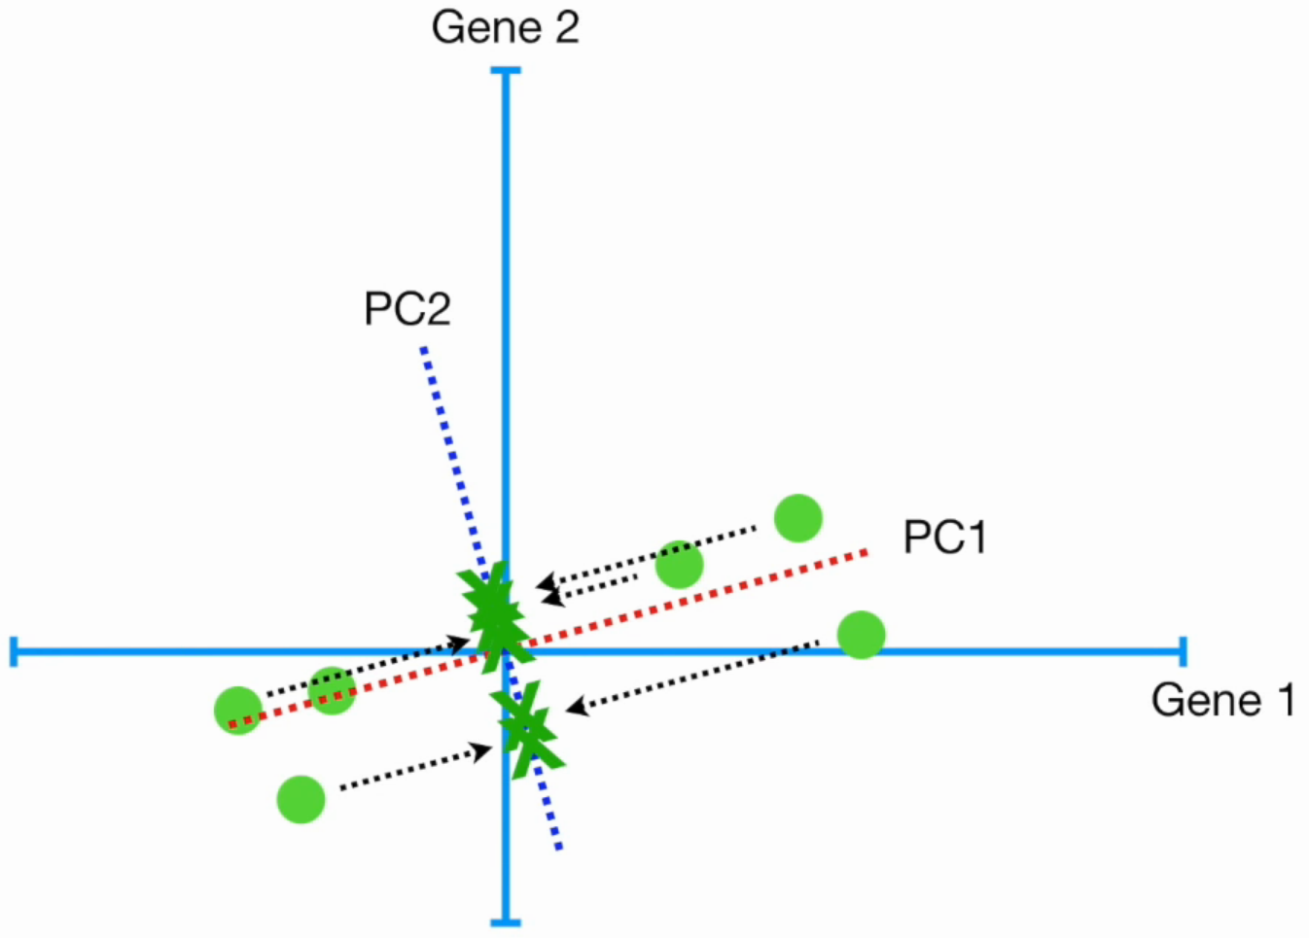
PCA under the hood
Build the covariance matrix
Calculate the Eigenvectors and Eigenvalues
Orthogonal transformation feature 1
Orthogonal transformation feature 2
Images source: StatQuest: PCA step by Step

Slide 24
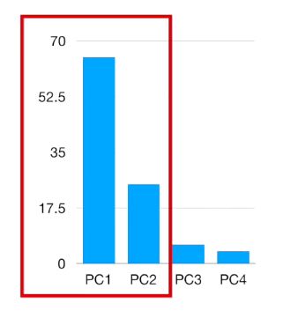
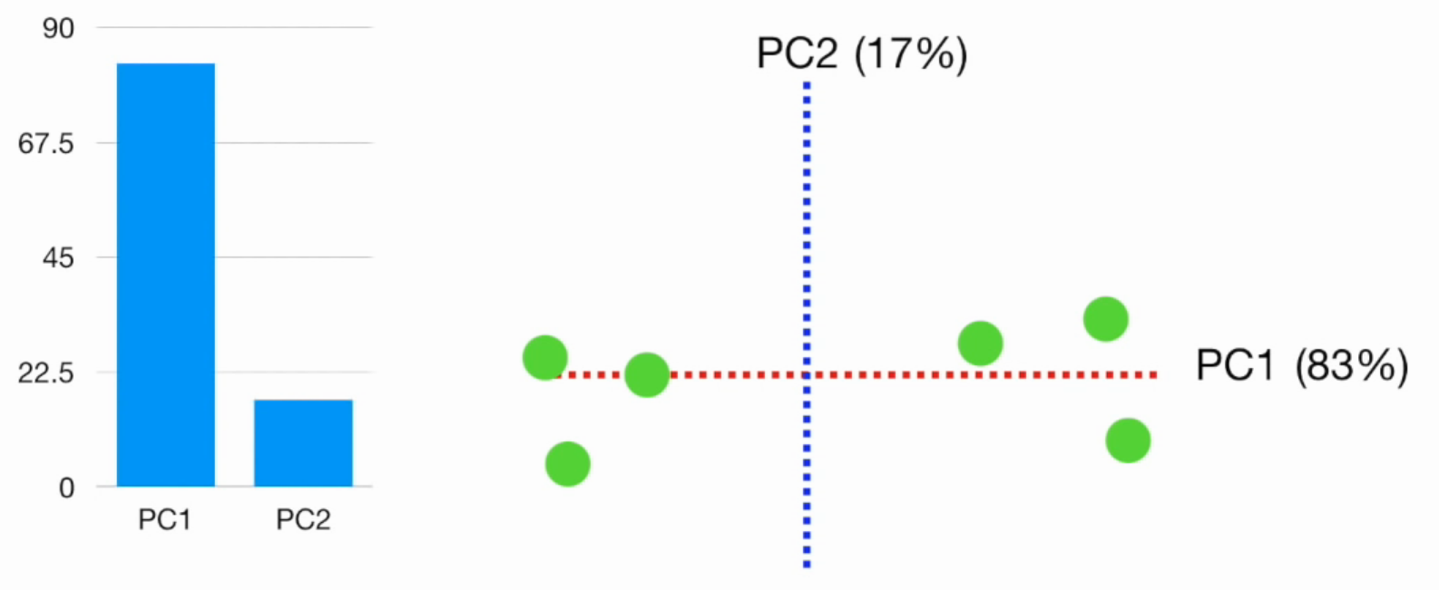
PCA under the hood
Compute Principal Components
Reduce the data dimensions
Compute Principal Components
Selected PC
Percentages of variation (%)s
Images source: StatQuest: PCA step by Step

Slide 25
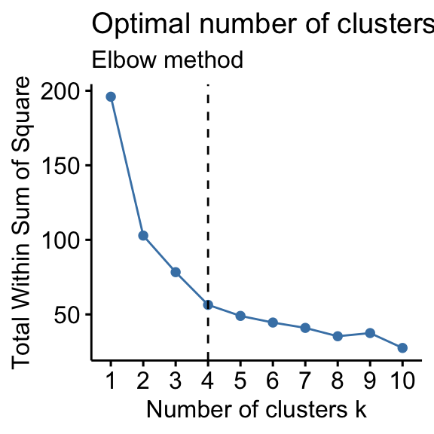
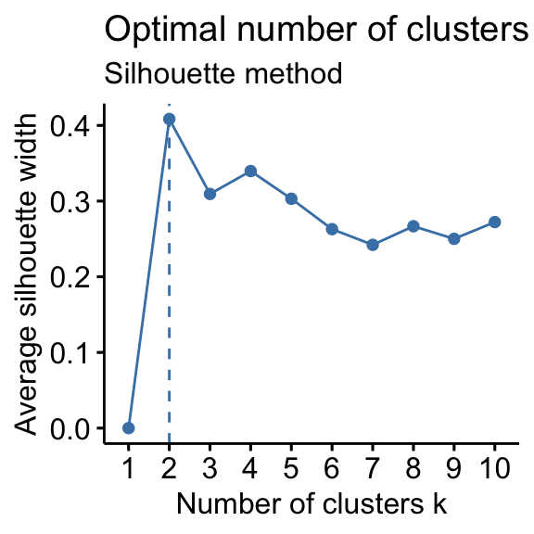
Number of clusters
Elbow method: A heuristic used in determining the number of clusters in a data set. The method consists of plotting the explained variation as a function of the number of clusters and picking the elbow of the curve as the number of clusters to use. The same method can be used to choose the number of parameters in other data-driven models, such as the number of principal components to describe a data set.
Silhouette method: method of interpretation and validation of consistency within clusters of data. The technique provides a succinct graphical representation of how well each object has been classified.

Slide 26
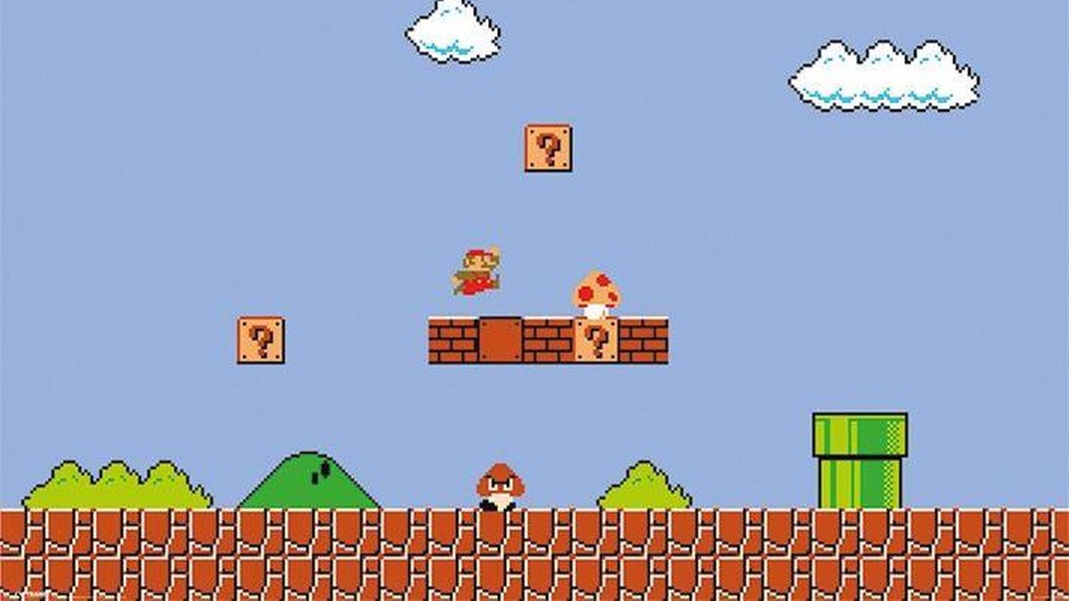
Let’s work on the challenge (Part 1)

Slide 27
Agenda
What is Unsupervised Learning?
What is clustering?
Types of clustering
Proximity measures
Clustering analysis standard workflow – PART 1
EDA and data processing
Dimensionality reduction: PCA
Finding the optimal number of clusters
Clustering analysis standard workflow – PART 2
Clustering algorithms: K-means
Evaluation metrics
Common industry applications

Slide 28
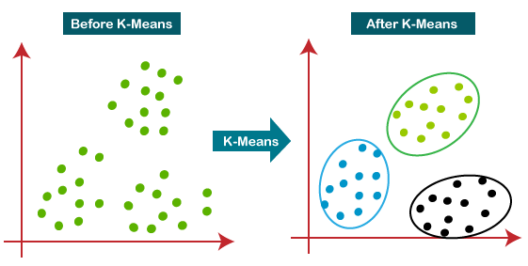
K-means
Step 1: Choose the number of clusters k
Step 2: Select k random points from the data as centroids
Step 3: Assign all the points to the closest cluster centroid
Step 4: Recompute the centroids of newly formed clusters
Step 5: Repeat steps 3 and 4

Slide 29
Other algorithms
Hierarchical clustering
DBSCAN
Spectral clustering
When the data is categorical: K-modes and k-prototypes

Slide 30

Evaluation metrics
Adjusted rand index
Fowlkes Mallows Score
Silhouette score
Calinski Harabaz index

Slide 31
Let’s work on the challenge (Part 2)

Slide 32
Agenda
What is Unsupervised Learning?
What is clustering?
Types of clustering
Proximity measures
Clustering analysis standard workflow – PART 1
EDA and data processing
Dimensionality reduction: PCA
Finding the optimal number of clusters
Clustering analysis standard workflow – PART 2
Clustering algorithms: K-means
Evaluation metrics
Common industry applications

Slide 33

Clustering applications
Common applications in the industry

Slide 34


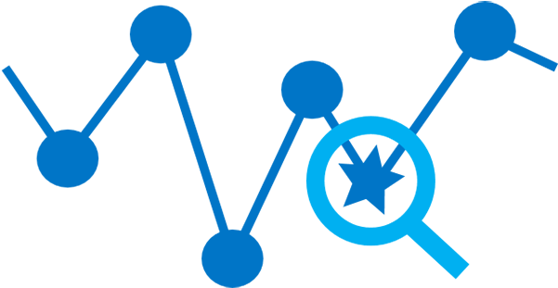
Customer segmentation
Anomaly detection
Association mining
Cluster analysis to target marketing outreach - Starbucks:
https://seifip.medium.com/starbucks-offers-advanced-customer-segmentation-with-python-737f22e245a4
Anomaly Detection Example with K-means in Python:
https://www.datatechnotes.com/2020/05/anomaly-detection-with-kmeans-in-python.html
Association Rule Mining using Market Basket Analysis:
https://towardsdatascience.com/market-basket-analysis-knowledge-discovery-in-database-simplistic-approach-dc41659e1558
Notes:
Algorithms for anomaly detection/clustering: https://towardsdatascience.com/best-clustering-algorithms-for-anomaly-detection-d5b7412537c8

Slide 35


Thanks!
Any questions?
You can find me at:
https://www.linkedin.com/in/daniela-miranda-restrepo/
Daniela.Miranda@unilever.com

